Slide 1
调研： 硅光芯片深度学习
2019.09.25

Slide 2
Shanhui Fan
Training of photonic neural networks through in situ backpropagation and gradient measurement, Optica, 2018.
Stanford Univ, Ginzton Lab, Stanford; Stanford Univ, Dept Elect Engn, Stanford

Slide 3
Zongfu Yu
Optimization of Nonlinear Nanophotonic Media for Artificial Neural Inference, Photonics Research, 2019
Univ Wisconsin Madison, Dept Elect & Comp Engn

Slide 4
Yichen Shen
Deep learning with coherent nanophotonic circuits, Nature Photonics
MIT, Elect Res Lab
Shen, YC; Harris, NC (通讯作者)
Tunable Efficient Unitary Neural Networks (EUNN) and their application to RNN, arXiv, 2017
MIT
Jing, L (通讯作者)

Slide 5
Nicholas C. Harris
Linear programmable nanophotonic processors, Optica, 2018
MIT
Englund, D (通讯作者)
Deep learning with coherent nanophotonic circuits

Slide 6
Dirk Englund
Large-Scale Optical Neural Networks Based on Photoelecric Multiplication, PHYSICAL REVIEW X 9, 2019
Quantum optical neural networks, Quantum Information, 2019
Trace-free counterfactual communication with a nanophotonic processor, Quantum Information, 2019
Variational Quantum Unsampling on a Programmable Nanophotonic Processor, CLEO, 2019
Deep learning with coherent nanophotonic circuits
Research Laboratory of Electronics, MIT

Slide 7
Marin Soljacic
Large-Scale Optical Neural Networks Based on Photoelecric Multiplication
*Gated orthogonal recurrent units: On learning to forget
Deep learning with coherent nanophotonic circuits
Mitgrating Knowledge between Physical Scenarios Based on Artificial Neural Networks, ACS Photonics, 2019
On-Chip Optical Convolutional Neural Networks
WaveletNet, Logarithmic Scale Efficient Convolutional Neural Networks for Edge Devices, arXiv, 2018
Department of Physics, MIT

Slide 8
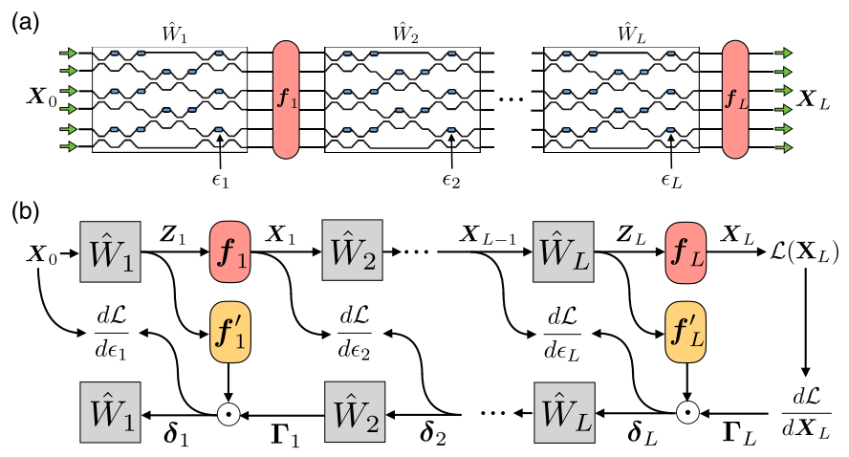
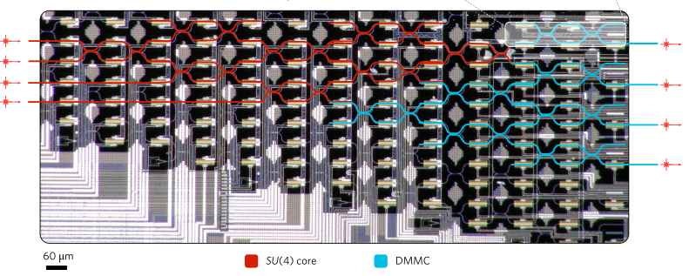
In situ backpropagation and gradient measurement
Schematic of the ANN architecture.
Illustration of operation and gradient computation in an ANN.
Shen Yichen etal., Deep learning with coherent nanophotonic circuits, Nature Photonics, 2017
Shanhui Fan et al., “Training of photonic neural networks through in situ backpropagation and gradient measurement”, Frontiers in Optics/ Laser Science, 2018.
training weights ex situ on a computer model of the system
creating final weights in the physical device using an idealized model that relates the matrix elements to the phase shifters
losing the potential advantages(对原文的评价)
in situ intensity measurements
Additional components:
physically implementing adjoint variable method

Slide 9
ANN的实现
input vector ---> output vector via matrices
tuning matrix elements (weights) for minimized cost function
tuning is implemented by “backpropagation algorithm”
utilizing the chain rule from the output layer to the input layer
对原文献的评价：
the training of the phase-shifter settings for this system was performed using a model implemented on a standard computer, which does not take into account experimental errors, and furthermore loses all the potential advantages in time and energy of the photonic implementation.
改进：
The only additional component that is required is a means to measure the light intensity in the vicinity of each of the tunable phase shifters.

Slide 10
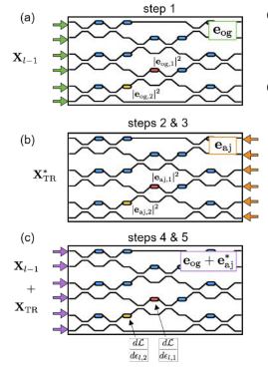
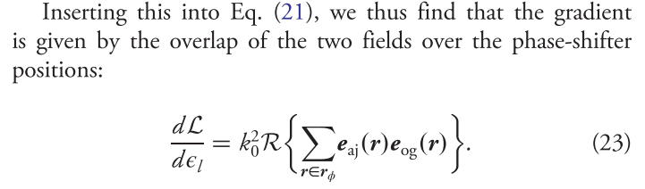
步骤
Send in the original field amplitude and measure and store the intensities at each phase shifter.
Send delta into the output ports and measure and store the intensities at each phase shifter.
Compute the time-reversed adjoint input field amplitudes.
Interfere the original and the time-reversed adjoint fields in the device, measuring again the resulting intensities at each shifter.
Subtract the constant intensity terms from steps 1 and 2 and multiply by k square to recover the gradient.
Shanhui Fan et al., “Training of photonic neural networks through in situ backpropagation and gradient measurement”, Frontiers in Optics/ Laser Science, 2018.

Slide 11
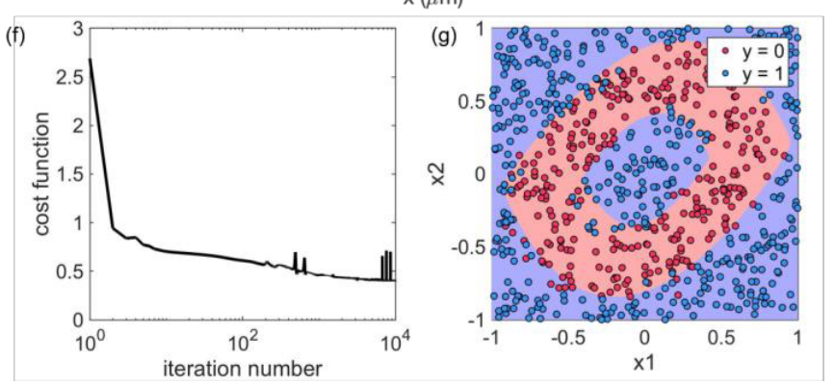
Restriction and Result
Assuming linear, lossless, reciprocal, feed-forward propagation inside the OIU.
Mode-dependent loss limits the ability to accurately reconstruct the time-reversed adjoint field.
40% of the light is lost due to back-scattering and radiation losses for 3 * 3 operation. (shown below)
Shanhui Fan et al., “In-situ Backpropagation in Photonic Neural Networks”, Frontiers in Optics/ Laser Science, 2018.

Slide 12
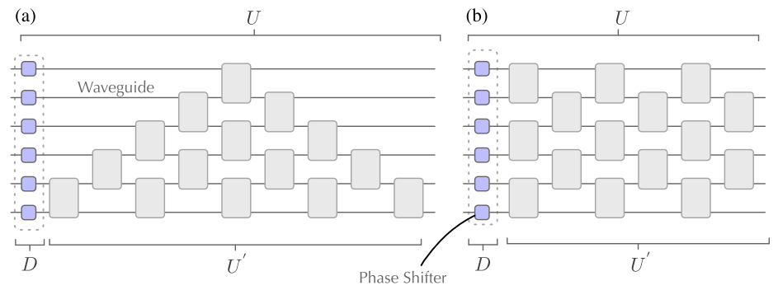
Linear programmable nanophotonic processors
(Nicholas C. let al., “Linear programmable nanophotonic processors”, Optica, 2018.)
N input to N output problem up into 2 x 2 mode transformers – Mach-Zehnder interferometers(MZI).
$Σ_{n}=N(N−1)/2$ MZI needed. For instance, n=6, $Σ_{n}=15$.
The SOI platform offers high index contrast of 3.4:1.5.
Largest PNPs – 88 MZIs connecting 26 optical modes(4.9 mm x 2.4 mm)
(a) reck(1994) (b)clement(2016)

Slide 13
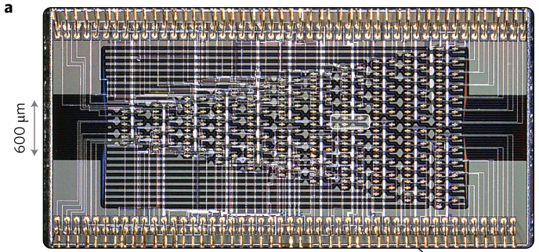
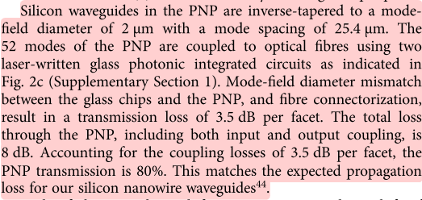
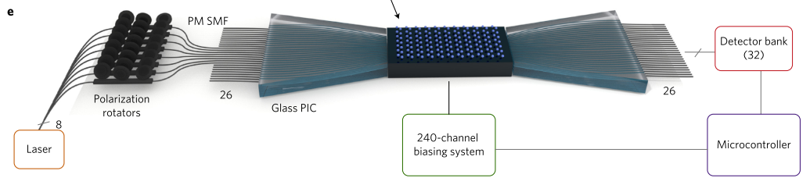
损耗
Processor composed of 88 MZIs, 26 input modes, 26 output modes and 176 phase shifters
(Nicholas C. let al., “Linear programmable nanophotonic processors”, Optica, 2018.)

Slide 14
Large-Scale Optical Neural Networks Based on Photoelectric Multiplication
特点
reduce E/MAC (the energy per multiply and accUmulate) from 20 pJ/MAC(ASICs, GPUs) to around 1 pJ/MAC.
1 fJ/MAC for modulator, rise above 1 pJ/MAC once the driver electronics and memory access are included
naturally adapted to free space optics
fundamental limits:
detector shot noise presents a standard quantum limit （光电探测器散粒噪声）
leading to classification error
C. M. Caves, Quantum-Mechanical Noise in an Interferometer, Phys. Rev. D 23. 1693 (1981)
pretraining weights on a GPU
computing Neural-network performance using Monte Carlo simulations
Ryan Hamerly et al., Large-Scale Optical Neural Networks Based on Photoelectric Multiplication, Physical Review X, 2019

Slide 15
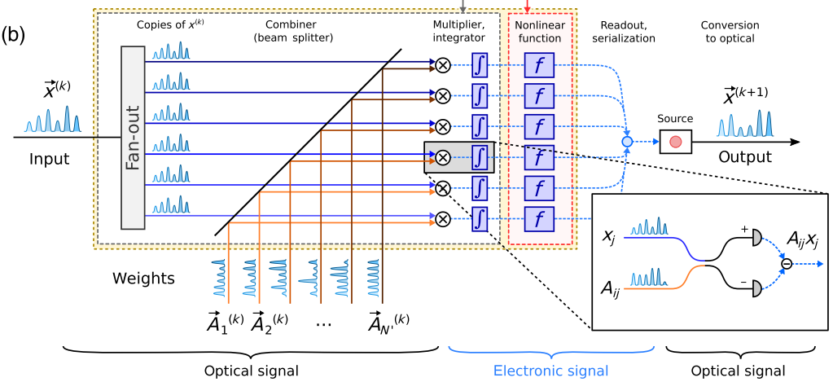

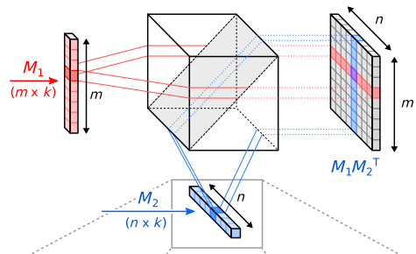
乘积值正比于探测器收到的电荷值
并行运算
running a batch of instances, X = [x1…xB], the output Y = [y1…yB] can be computed through the matrix-matrix product Y = AX
上图：计算过程
左图：并行计算
Ryan Hamerly et al., Large-Scale Optical Neural Networks Based on Photoelectric Multiplication, Physical Review X, 2019

Slide 16
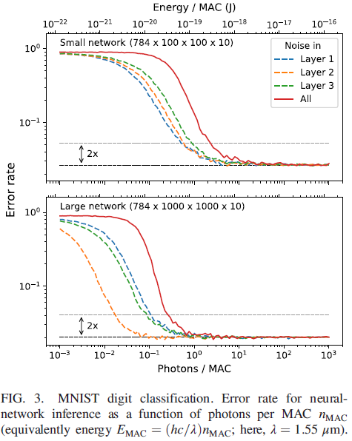
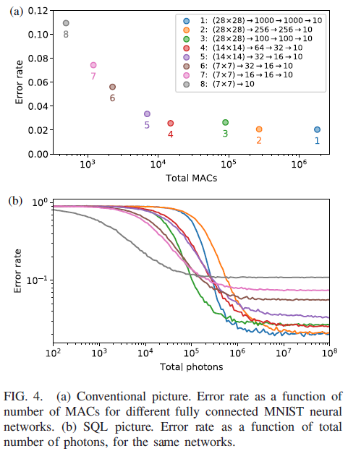
Results
Ryan Hamerly et al., Large-Scale Optical Neural Networks Based on Photoelectric Multiplication, Physical Review X, 2019

Slide 17
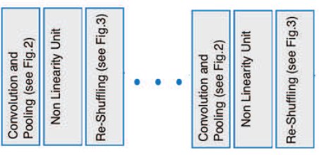
On-Chip Optical Convolutional Neural Networks
Convolutional Neural Networks (CNN): convolving input images with filter-kernels for object recognition and classification purposes
input image → convolution and pooling layers → mapping output to classification targets
Hengameh Bagherian et al., On-Chip Optical Convolutional Neural Networks, arXiv, 2018

Slide 18
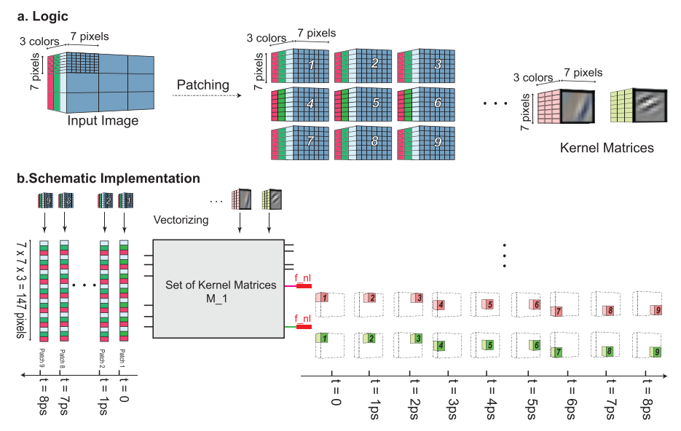
Hengameh Bagherian et al., On-Chip Optical Convolutional Neural Networks, arXiv, 2018

Slide 19
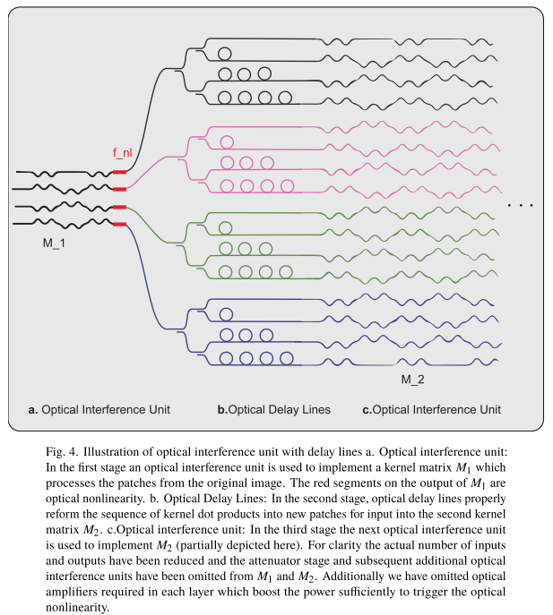
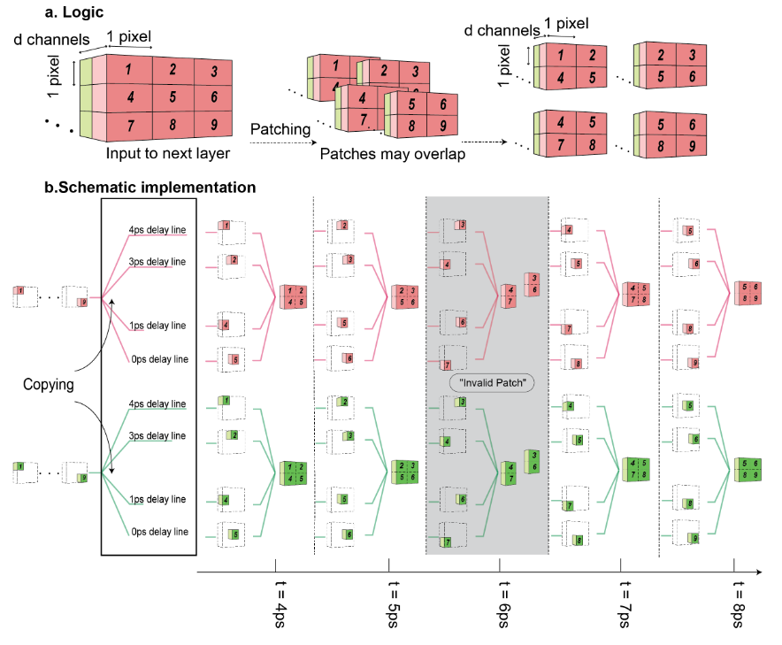
Hengameh Bagherian et al., On-Chip Optical Convolutional Neural Networks, arXiv, 2018

Slide 20
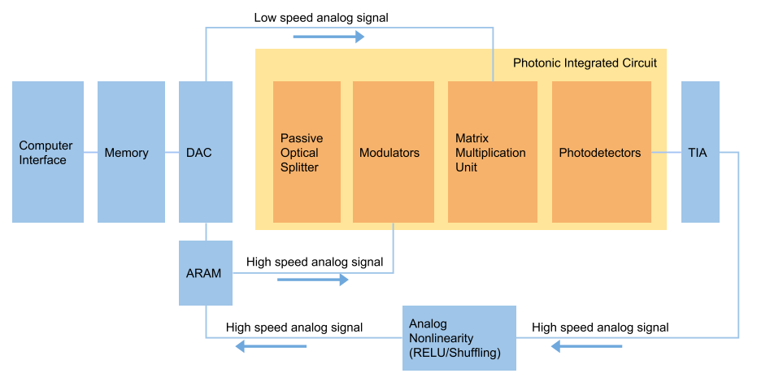
Hengameh Bagherian et al., On-Chip Optical Convolutional Neural Networks, arXiv, 2018

Slide 21
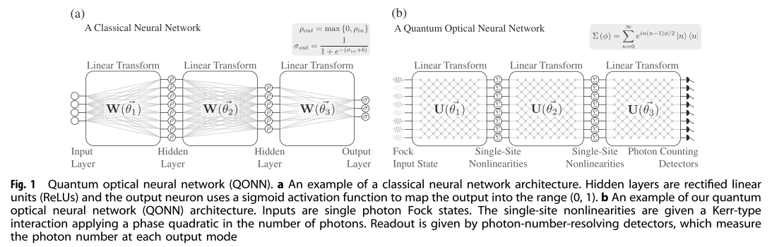
Quantum optical neural networks (Dirk Englund)
mapping quantum optics features(mode mixing, optical nonlinearity) to neural networks
similar architecture
CMOS-compatible platform instead of photonics chips
Application: quantum information processing tasks: quantum optical state compression for quantum networking and black-box quantum simulation
Gregory R. Steinbrecher et al.,Quantum optical neural networks, Quantum Information, 2019

Slide 22
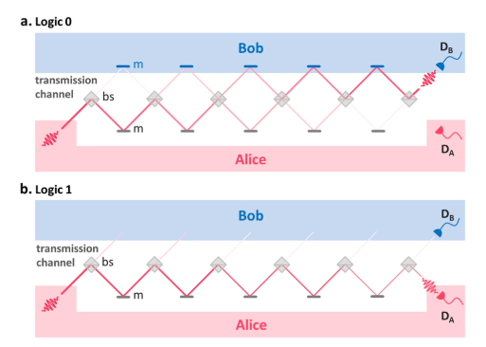
Trace-free counterfactual communication with a nanophotonic processor
Performing Quantum communication
Performing high-fidelity counterfactual communication protocol without post-selection enabled by a programmable nano-photonic programmable nanophotonic processor
implement CFC protocol using two to six concatenated beam splitters on the same photonic chip
high (99.94%) average visibility of
the individual integrated interferometers
allowed bit error probabilities as
low as 1.5%
I. Alonso Calafell et al.,Trace-free counterfactual communication with a nanophotonic processor, Quantum Information, 2019

Slide 23
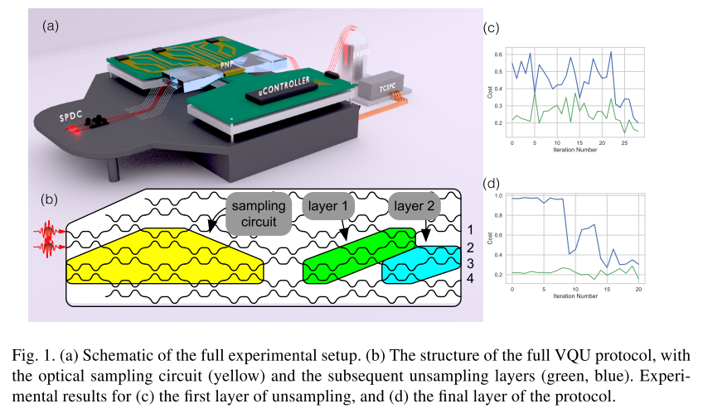
Variational Quantum Unsampling on a Programmable Nanophotonic Processor
Implementing VQU protocol for verification and inference of near-term quantum circuits outputs
performs optimization on $|\left.{\text{ψ}}_{out}\right\rangle$using a sequence of auxiliary quantum circuits $\hat{V}(\vec{∅})$ to find the time reversed condition$\hat{V}\left(\vec{∅}\right)=U^{\text{†}}$for a known input state
Jacques Carolan et al., Variational Quantum Unsampling on a Programmable Nanophotonic Processor, CLEO 2019

Slide 24
问题：
电路中的精度是什么？
光路中的精度与哪些因素有关？
这些因素在电路中是否也要考虑？为什么？
为什么和其他因素无关？

Slide 25
电路中精度
计算的精细程度
电平高低表示“0”和“1”
精度不受限于硬件
理论上可以实现无线高精度的计算（耗时）

Slide 26
光路中精度
模仿电路中使用高低电平来表示“0”和“1”
所以理论上只要能分辨出“0”和“1”，该光路就可以用于计算，但是存在计算速度的问题。
达到精度要求：可以分辨出“0”和“1”
相关因素：取决于具体结构
探测器灵敏程度
芯片设计的复杂程度
（以linear programmable processor为例）

Slide 27
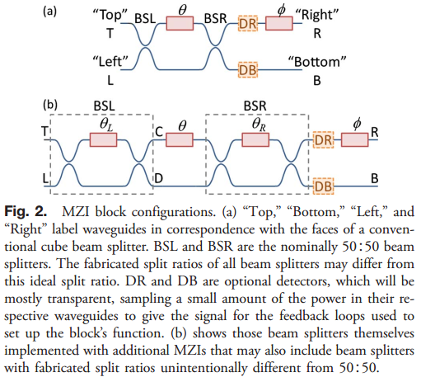
Split ratio
performance is limited by beam splitters that deviate from the ideal 50∶50 split.
setting them up using a “beam splitter 50: 50 setup algorithn” (BFSA) to be 50: 50 in a MZI based only on maximizing or minimizing power on a detector
using a double Mach-Zehnder interferometer (DMZI) configuration as if it were a perfect MZI with 50: 50 beam-splitter ratios
“mesh 50: 50 setup algorithm”(MFSA)
DAVID A. B. MILLER, Perfect optics with imperfect components, Optical Society of America, 2015

Slide 28
MZI的排列方式
new design based on an alternative arrangement of beam splitter and phase shifters
half the optical depth of the Reck design and is significantly more robust to optical losses
(a) reck(1994) (b)clement(2016)
Willian R. Clements, Optimal design for universal multiport interferometers, Optica, 2016

Slide 29
Losses

Slide 30
问题：
fiber tip的自定义加工（polish等）
长飞 和 烽火未找到

Slide 31
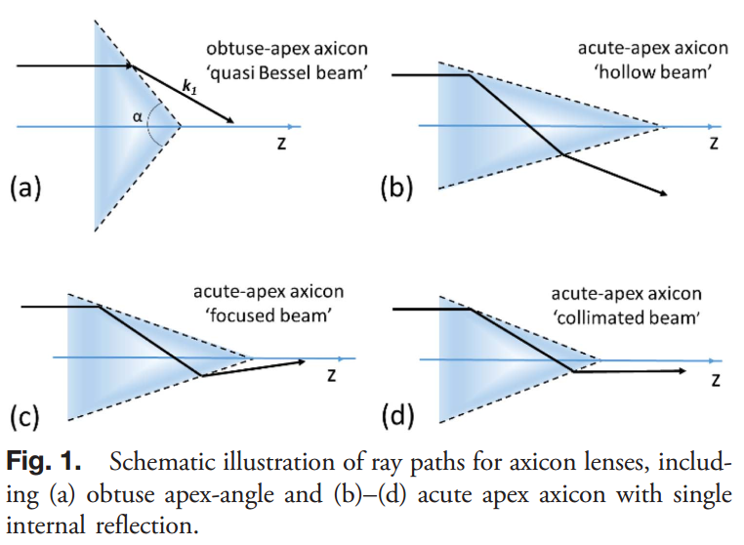
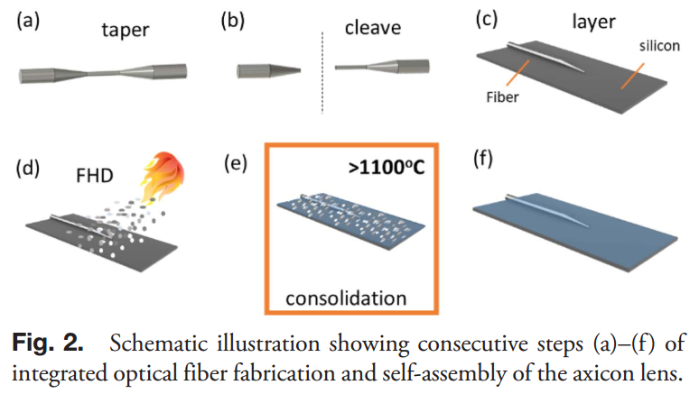
Axicon lenses
加工过程
tapering using micro-heaters
flame hydrolysis deposition (FHD) processes
产生Bessel光束
Christopher Holmes et al., Self-assembled axicon lens in integrated optical fiber, Optics Letters, 2019

Slide 32
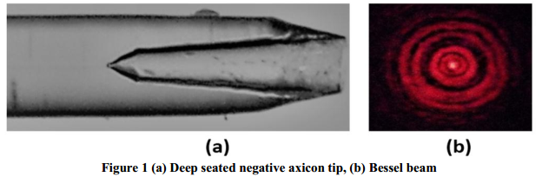
Deep seated negative axicon (DSNA) probe
fabricated at the distal end of a single mode optical fiber
highly Ge doped inside both core and cladding by a chemical etching procedure
In this process, the fiber end is cleaved after removing the jacket of the fiber such that only core and cladding part of fiber undergo the etching and placed on the surface of the convex meniscus formed by 48% HF and toluene in a tube of ~2mm diameter under the controlled conditions. The etching occurs both side-wise and inside the fiber due to the capillary action, but the later action is foremost in DSNA formation.
P. Gupta et al., Application of Bessel Beam from Deep Seated Negative Axicon in Optical Coherence Tomography of Tissue Structure, SPIE, 2019

